Slide 1
Driving Repurchase Intent: Olist Regional Logistics & Loyalty Analysis
Ning-Hsiang Weng
Database Management: PostgreSQL
Data Visualization: Power BI

Slide 2
01. Dataset Overview & Research Objectives

Slide 3
Dataset Overview
100k Real Orders: Comprehensive commercial data spanning from 2016 to 2018 across multiple marketplaces in Brazil.
Multi-Dimensional Features: Covers the entire e-commerce lifecycle including order status, pricing, payment methods, freight performance, and product attributes.
Anonymized: Real commercial data anonymized for privacy.

Slide 4
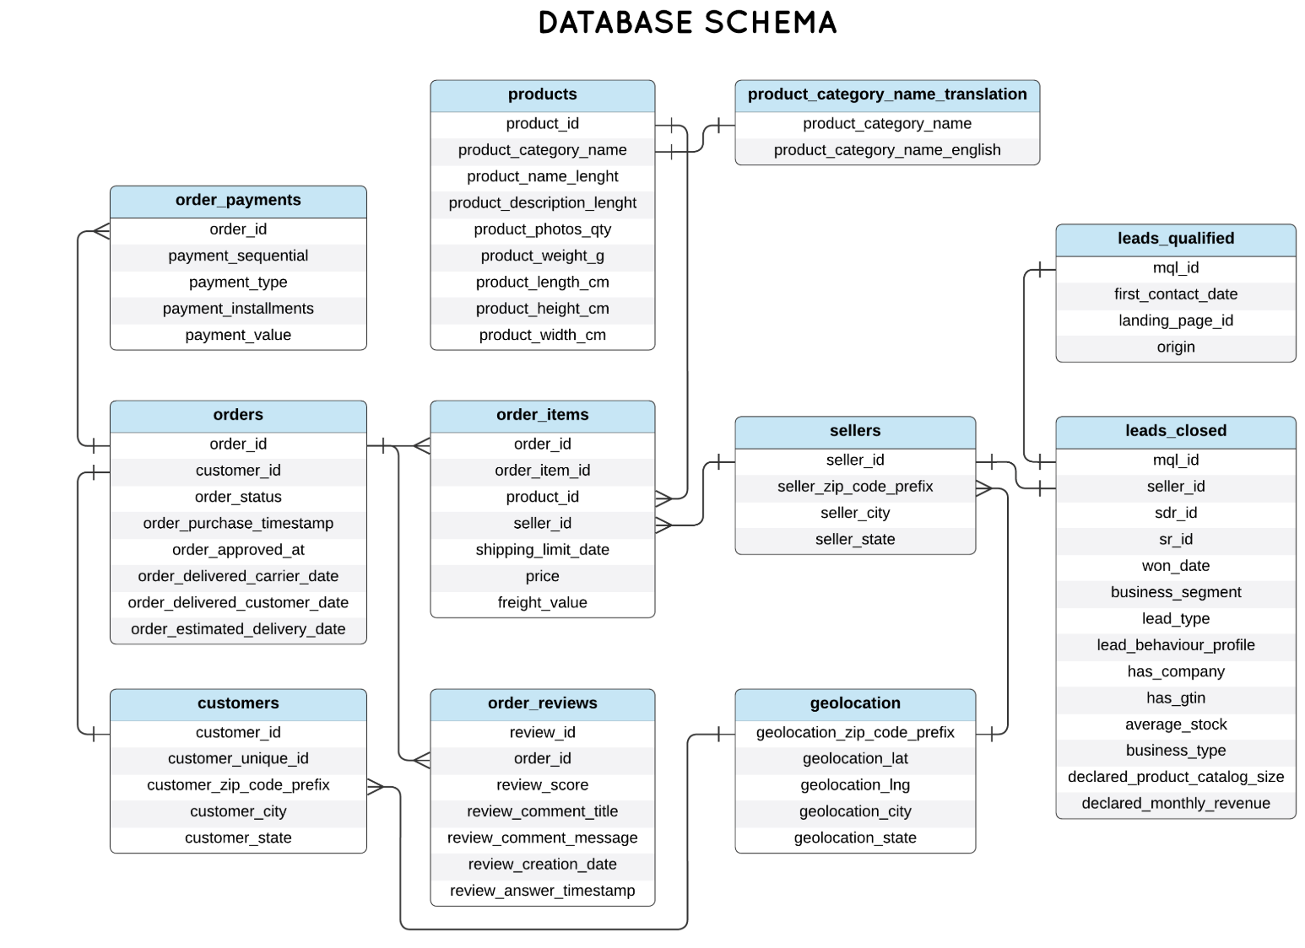
PK
PK
FK
PK
FK
PK
PK
PK
FK
PK
PK & FK
FK
FK
FK
PK: geolocation_id
PK
PK
FK

Slide 5
Motivation: Low Repeat Purchase and State-Level Variation
Key Observation: Strong One-Time Purchase Pattern
3.12% Repeat Purchase Rate: Only 3k out of 96k unique customers reordered (Avg. 1.03 orders/customer).
Regional Retention Variance: Repeat purchase rates vary significantly by customer's main state.

Slide 6
State-Level Logistics & Customer Retention Analysis
Aim:
Analyze Retention Drivers:
Evaluate if freight costs, cross-state shipping, delivery times, and review scores impact regional repeat purchases.
Optimize Operations:
Identify logistical and satisfaction pain points to improve customer retention and strategy.

Slide 7
02. Data Preparation & Cohort Selection

Slide 8
Data Pipeline
Raw Olist Dataset (N = 99441 orders)
Filter by Order Status
Step 1. Effective Orders Only (N = 96478 orders)
Retained: 'delivered' status only (97.02%)
Customer Roll-up
Step 2. Unique Customer Level (N = 93358 customers)
Grouped by customer_unique_id (resolving 1-to-many ID mapping)
Cohort Observation Window
Step 3. 6-Month Maturity Filter (N = 56949 customers)
Excluded: Customers whose first purchase was < 6 months ago
Step 4. Metric Selection & Baseline Setup
Shipping Duration ➔ Handled 2 missing dates ➔ Defined by Median
Freight Cost ➔ Confirmed 100% complete ➔ Defined by Median
(56947 customers with 59494 shipping records)
Review Score ➔ Deduplicated multi-reviews ➔ Kept latest score only
(56528 customers with 59039 scores )

Slide 9
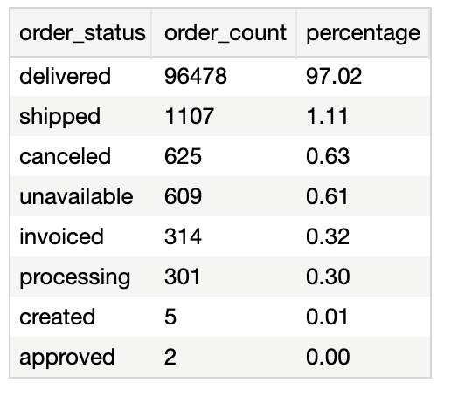
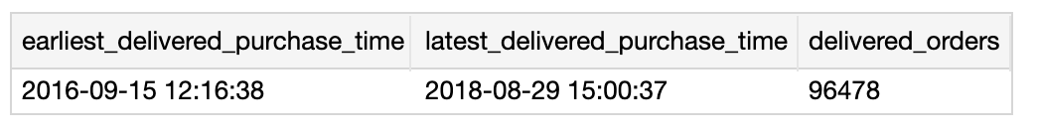
Step 1. Defining "Effective Orders"
Scope Limitation:
Analysis is strictly limited to successful, fulfilled orders (delivered status: 97.02%).
Purpose:
Eliminates statistical bias to ensure accurate measurement of true repurchase cycles and physical logistics duration.

Slide 10
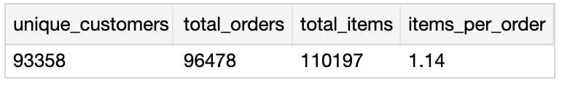
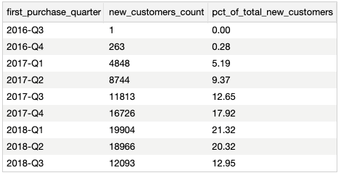
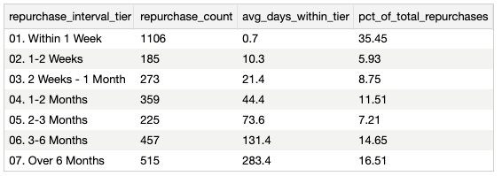
Step 2. Customer Definition & Cohort Selection
Evaluated retention using customer_unique_id instead of customer_id to account for one-to-many mapping (multiple orders/IDs per unique user).
6-Month Cohort Filter:
Excluded users whose first purchase occurred less than 6 months ago.
Ensures newly acquired users have a sufficient observation window to exhibit natural repurchase behavior, preventing underestimation of true retention.
顧客首次購物時間點

Slide 11
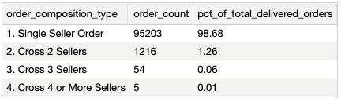
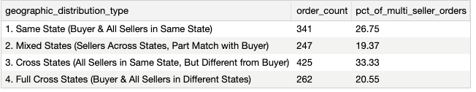
Step 3. Cross-State Order Definition
Multi-item orders frequently involve multiple sellers and distinct regional origins.
An order is classified as "Cross-State" if at least one item is shipped from a seller located in a different state than the buyer.

Slide 12

Step 4. Delivery Time / Shipping Duration
Purged 24 records with missing or unnormal delivered_date values to ensure timeline completeness.
Identified severe right-skewness in shipping performance, where P95 is 29.27 days but the maximum extends to 209.63 days.
Adopted the median as the primary metric, ensuring robustness against extreme outliers and tracking true operational timelines.
Validation confirms extreme delays are scattered randomly across states with negligible ratios (mostly <0.5%), ruling out regional systemic bias.

Slide 13
Step 4. Freight Cost / Shipping Fee Filters
Confirmed 100% data completeness with zero null or negative records in the freight cost attribute
Detected a heavy tail in shipping fees; while 95% of orders cost under 54.78, extreme outliers spike up to 1794.96.
Standardized on the median as the central tendency measure, ensuring robustness against anomalous logistics pricing.

Slide 14
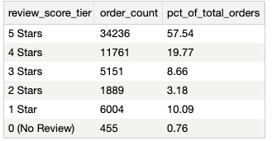
Step 4. Review Score / Customer Rating Filters
For orders with multiple reviews, only the latest score is retained to ensure a strict 1:1 order-to-review mapping.
Low Review Score
Exclude

Slide 15
03. Preliminary Analysis & Regional Retention Drivers

Slide 16
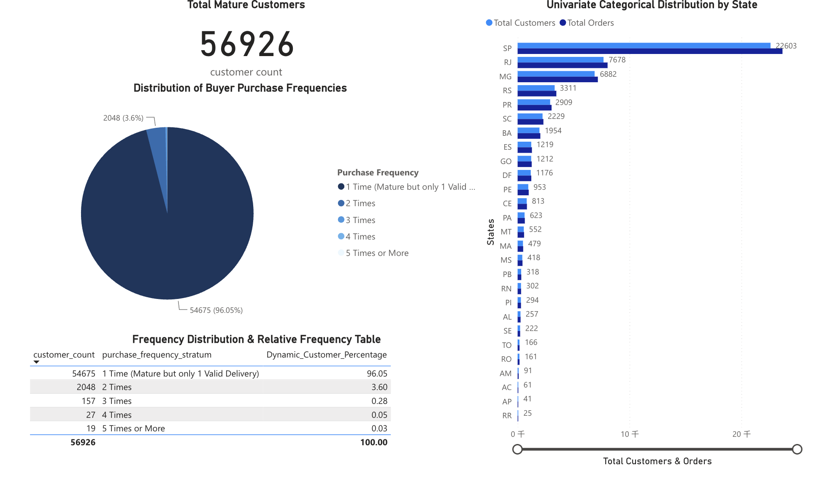
Preliminary Analysis: Geographic Disparity in Customer Density & Retention Rates
Severe Geographic Imbalance:
Most orders are in SP (22,603 orders). Other states have very few orders.
Very Low Repeat Rate: Out of 56,926 mature customers, 96.05% bought only once. Very few people buy again.

Slide 17
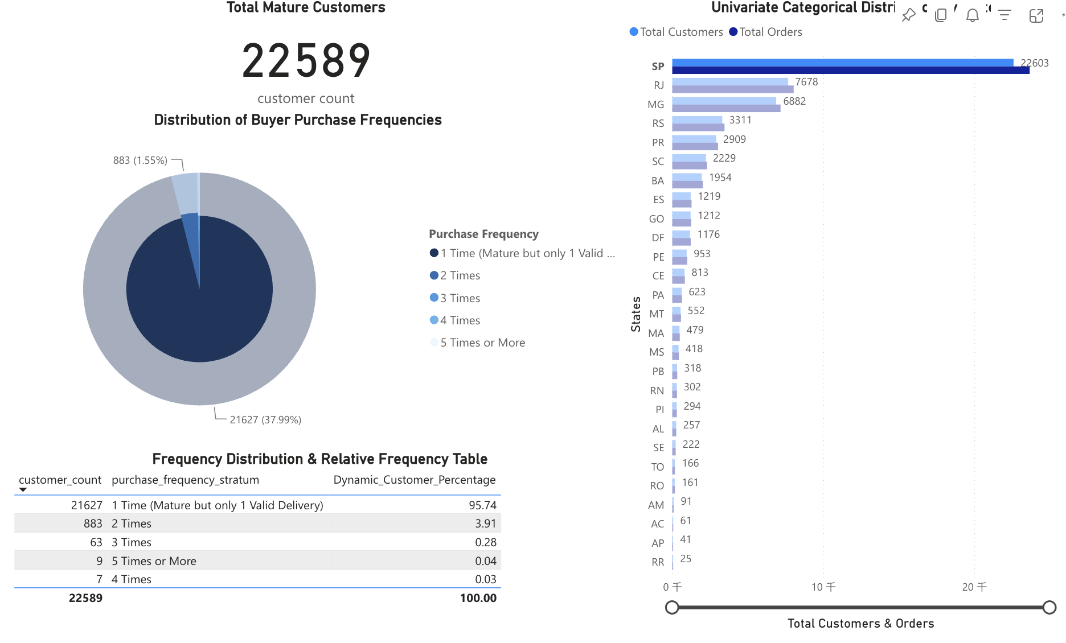
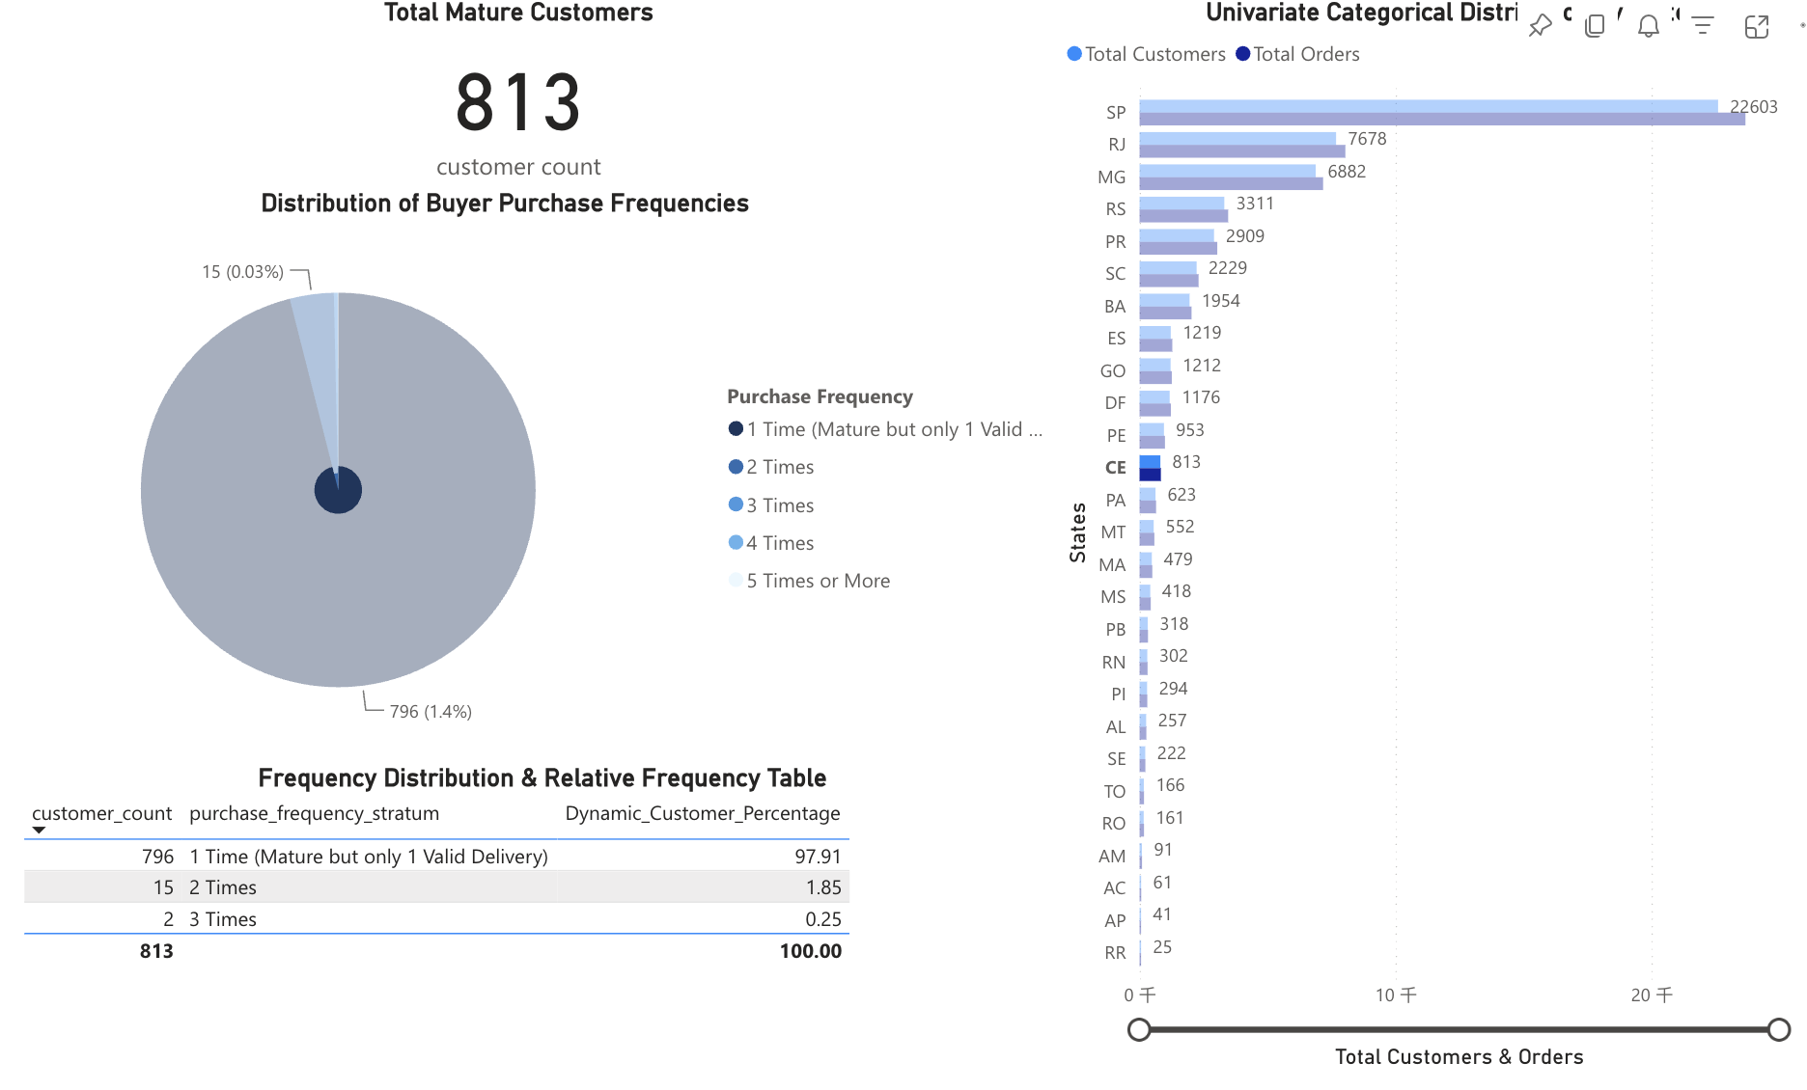
Big Gap Between States:
Repeat rates differ by location: SP reaches 4.26%, while distant CE drops to 2.09%—almost cut in half.

Slide 18
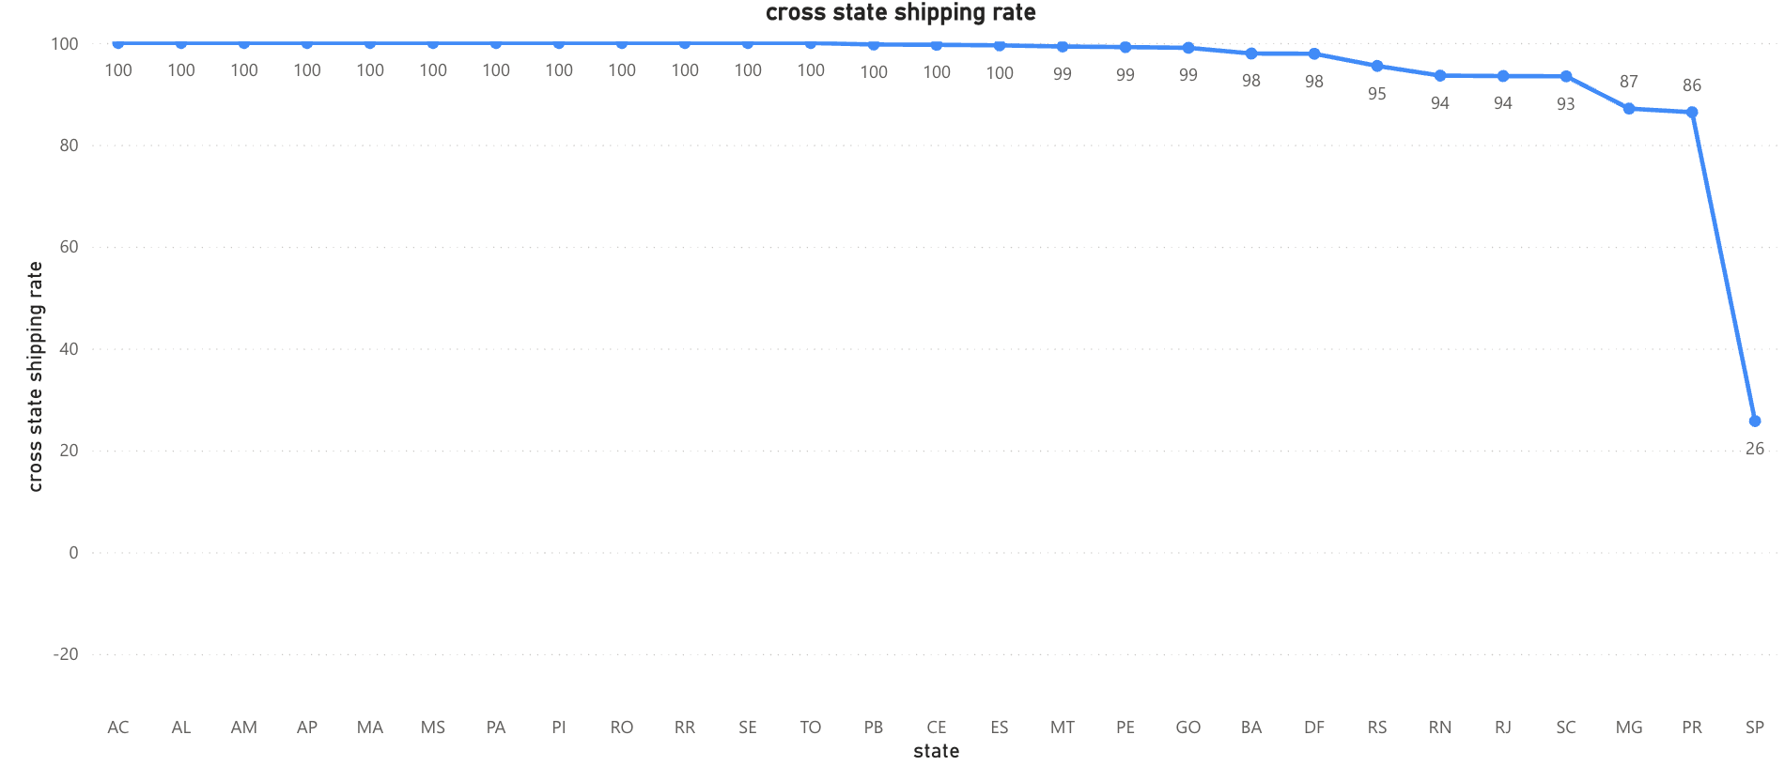
Cross-State Shipping Ratio by State
Except for SP, all other states have cross-state ratios between 86% and 100% (CE is 100%).
SP has a very low cross-state ratio of only 26%. Most orders stay inside the state.
To analyze the data more clearly, states are grouped by their shipping patterns to observe different customer experiences:
Pure Cross-State: Observing remote areas that rely entirely on out-of-state shipping.
Mixed Logistics: Observing states with both local and out-of-state shipping options.

Slide 19
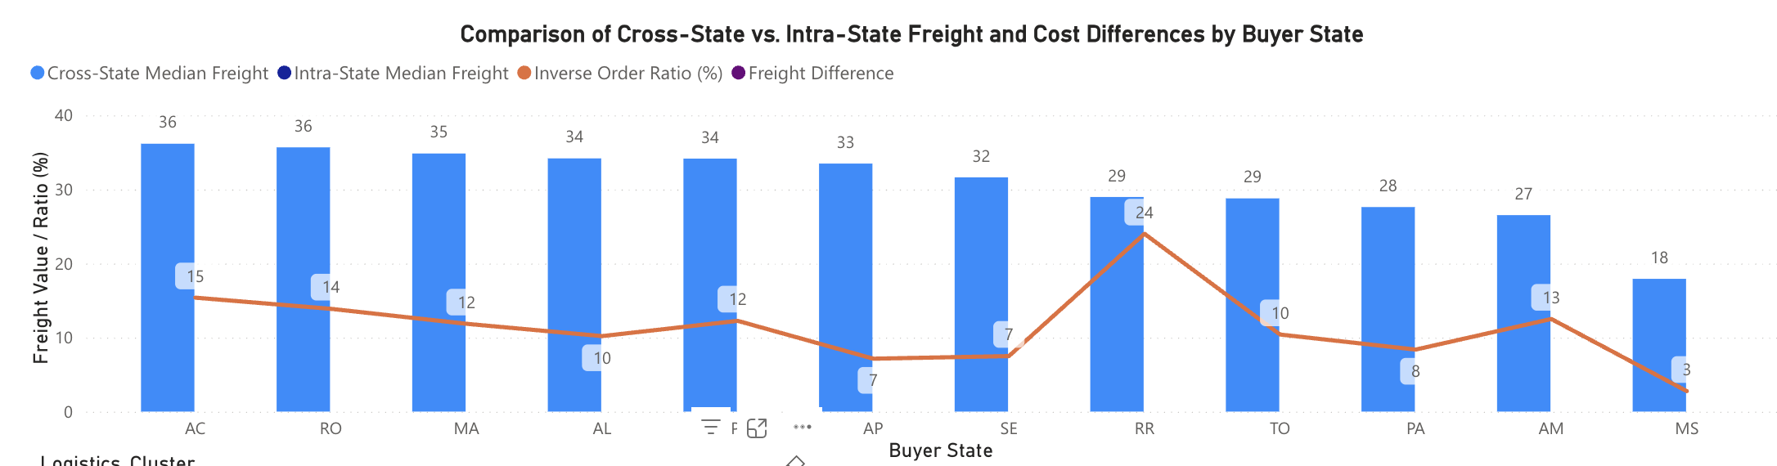
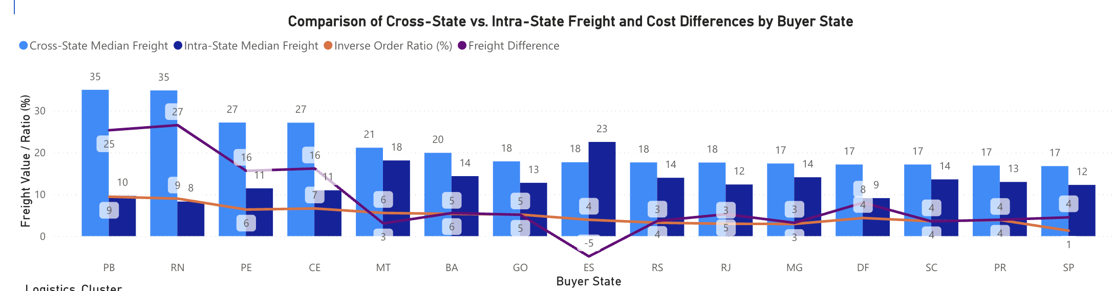
Preliminary Freight Analysis: High Cost Barriers for Out-of-State Buyers
High Fees in Remote States: Remote states pay high fees of 34-36 with zero cheap local options.
High "Cross-State Tax" in Mixed States: In PB and RN, cross-state shipping is 3-4x more expensive than local (difference of 25-27), while SP has almost no difference.

Slide 20
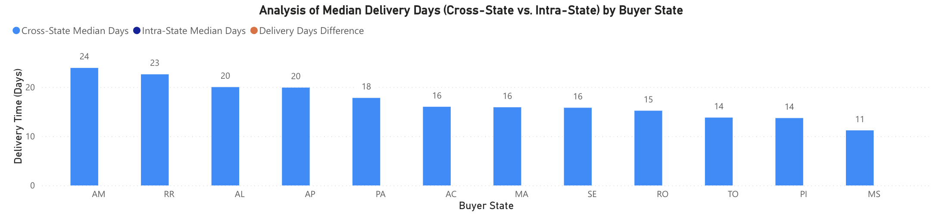
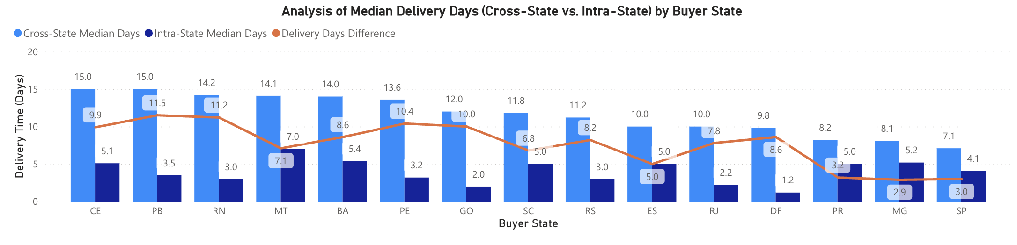
Preliminary Freight Analysis: High Cost Barriers for Out-of-State Buyers
Extremely Long Wait in Remote States: Remote states face very long wait times of 23-24 days with zero fast options.
Significant Delivery Gap in Mixed States: In PB and RN, cross-state delivery is 3-4x slower than local (difference of 11+ days), while SP has almost no difference.

Slide 21
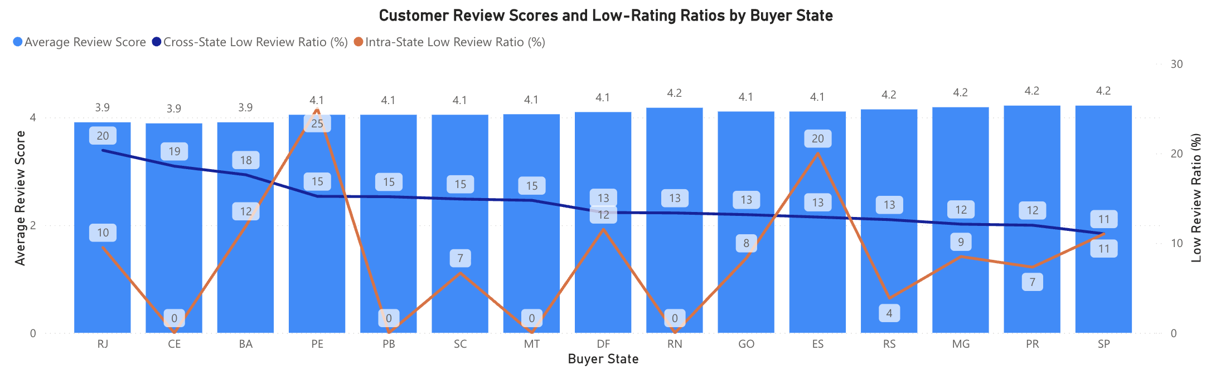
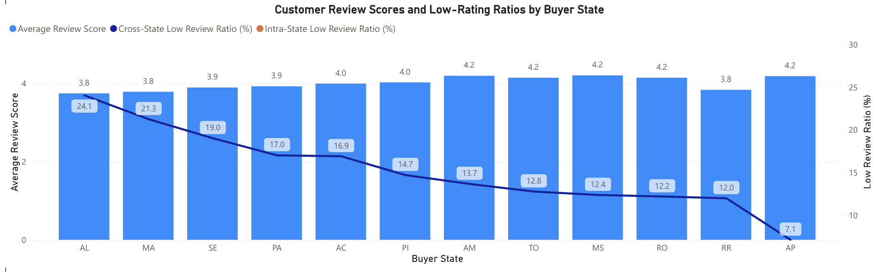
Preliminary Review Analysis: Hidden Dissatisfaction for Out-of-State Buyers
Deceptive Average Scores: Average scores are very close (3.9 to 4.2) across all states, which easily hides real customer pain points.
To avoid misleading averages, future analysis will use "Low-Rating Ratio (1 & 2 stars)" as the main metric to measure satisfaction.
High "Low-Rating Ratio" in Cross-State Orders: Cross-state orders (dark blue line) have much higher low-ratings. Distant CE has a 19% low-rating ratio, while SP is only 11%.

Slide 22
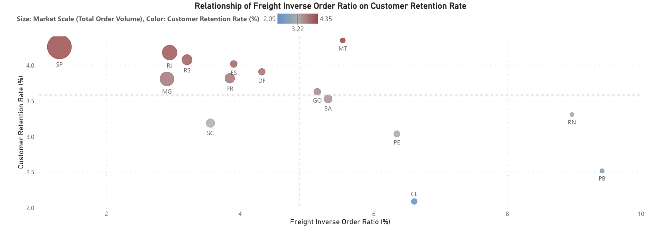
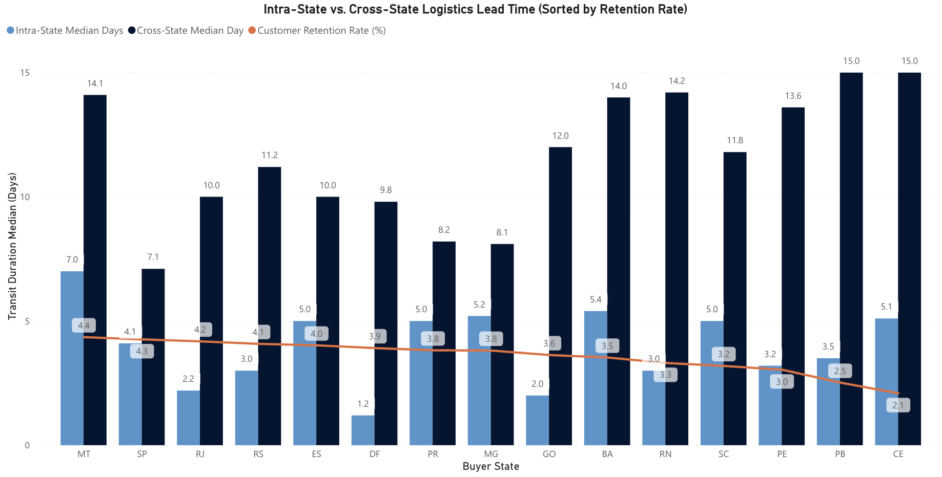
Result Analysis: Mixed Shipping States
The Freight-Reverse Penalty
Overall Negative Correlation: Higher freight-to-product cost ratio overall correlates negatively with customer retention.
Cost Inversion & Retention Collapse: ~10% of orders in PB & RN face cost inversion (freight > product), dragging retention down to its lowest levels .
Logistical Lead Time & Transit Gaps
The 10-Day Delivery Gap: Low-performing PE/CE /PB face 15-day cross-state waits—over 10 days slower than local shipping (3-5 days).
Slower Delivery, Lower Retention: Regional retention drops steadily as the transit gap between local and cross-state shipping widens.
MT Exception
High Friction, High Loyalty: Despite high freight costs and 14.1-day delays, MT leads retention at 4.4%, proving a strong captive market with rigid demand.

Slide 23
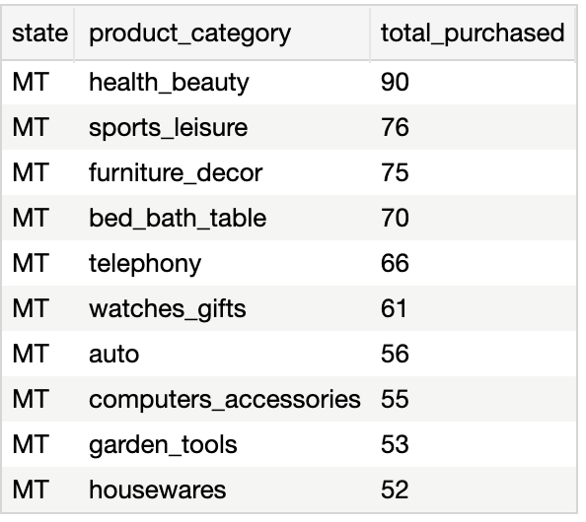
Improvement Plan
Group 1: RN, PE, PB, CE (High Freight Costs, Slow Delivery)
Give Free Shipping: Offer free shipping to stop customers from paying more for delivery than the product itself.
Speed Up Delivery: Work with faster shippers to cut down the long 15-day waiting time.
Group 2: RJ & RS (Good Repeat Rates, But Can Be Better)
Keep Them Happy: These states already have good repeat buyers, but we must not let them wait too long.
Deliver Faster: Improve cross-state shipping speeds so customers don't have to wait so many days.
Group 3: MT (Mato Grosso — Loyal Buyers with Real Needs)
Keep Popular Items in Stock: Always have enough stock for the specific products they need and buy most, such as health & beauty and sports & leisure products.
Offer Shipping Discounts: Give them special shipping discounts to thank and keep these loyal, high-value customers.

Slide 24
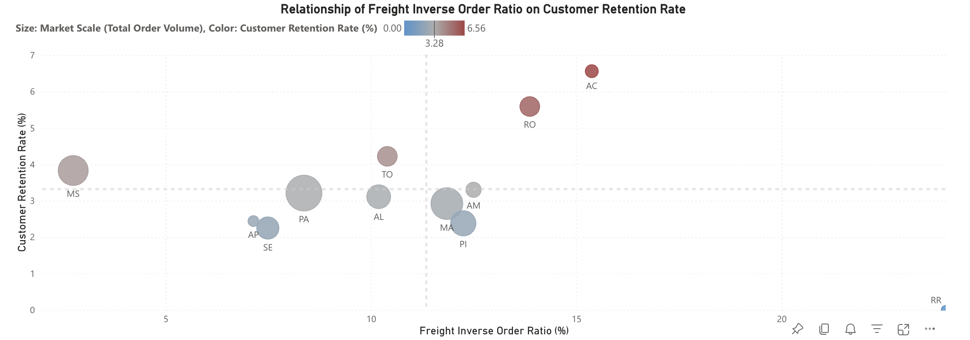
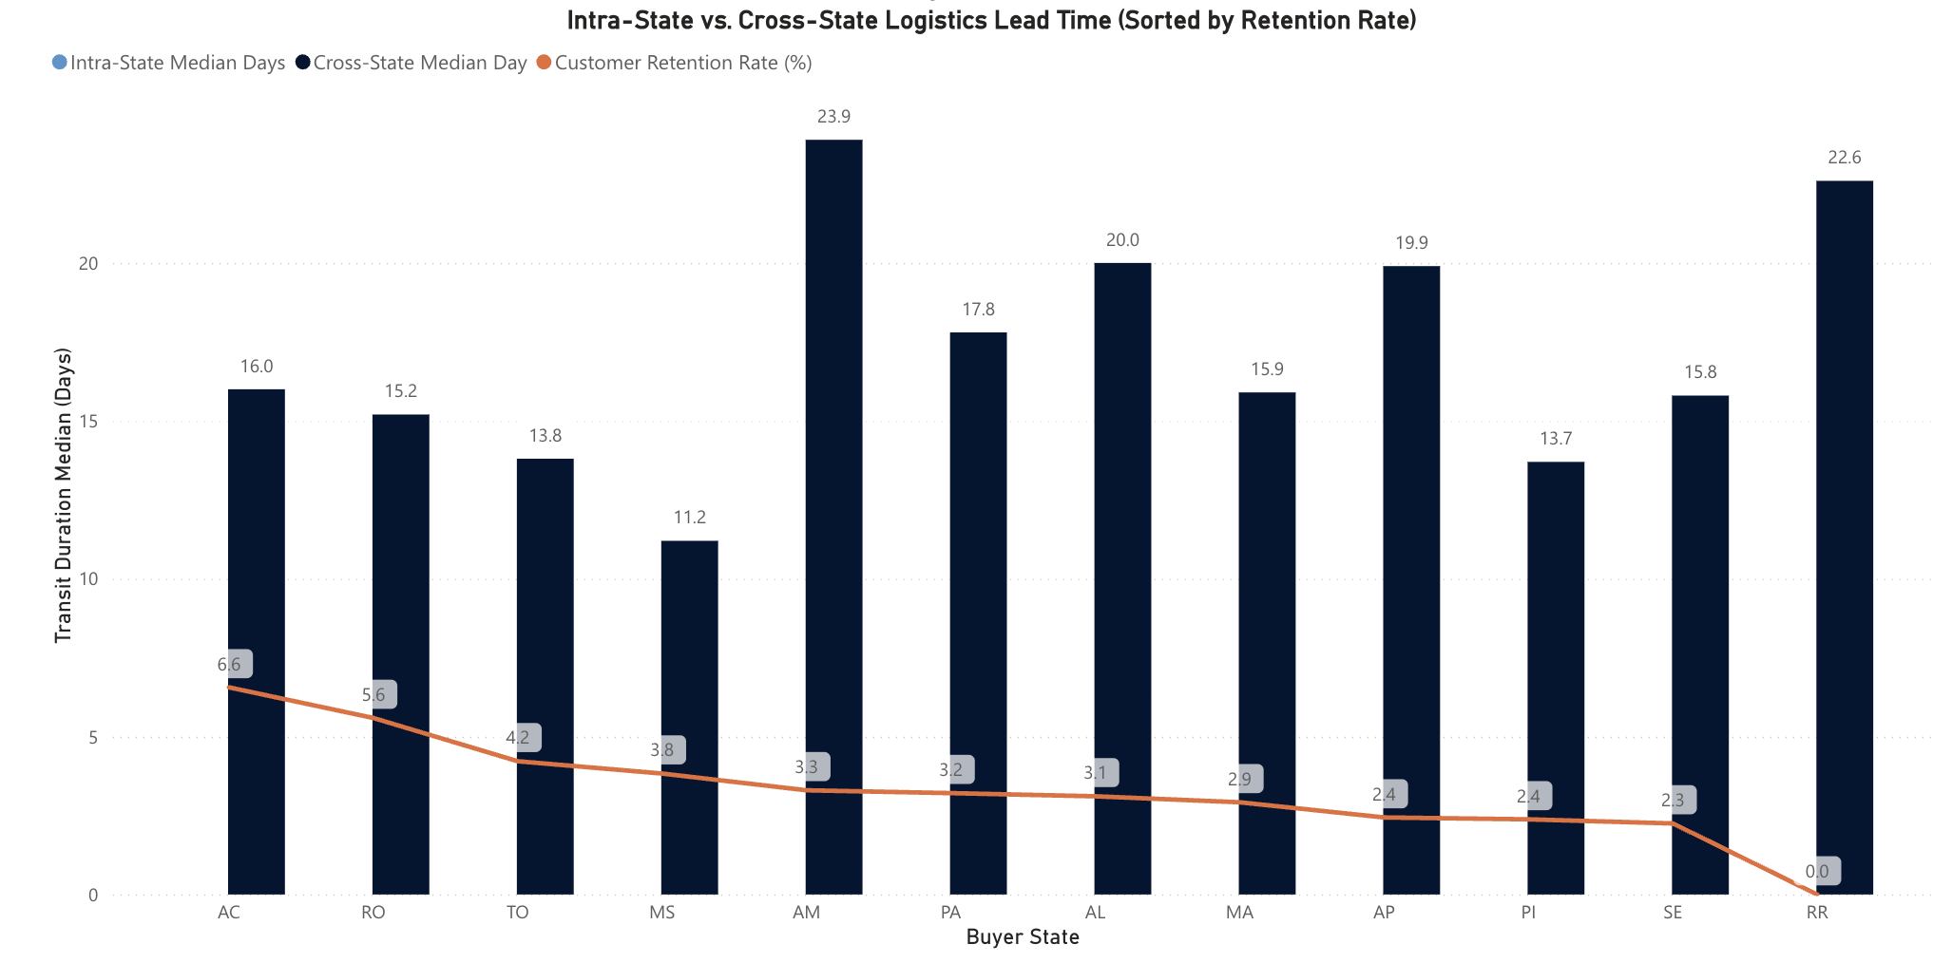
Result Analysis: Pure Cross-State Shipping States
The AC & RO Growth Opportunity: They face high shipping costs but average waiting times. Surprisingly, their repeat rates are outstanding (6.56% and 5.59%).
Delivery Speed is Key: Delivery speed matters more than the freight cost ratio. PA and AL have similar or better freight cost ratios than TO, but much longer wait times (18–20 days vs. TO's 13.8 days). This long wait drags their repeat rate down to ~3%.

Slide 25
Improvement Plan
Group 1: AC & RO (High Costs, High Loyalty)
Give Shipping Discounts: Since they are already highly loyal, lowering their shipping costs will easily get them to buy much more.
Group 2: PA & AL (Slow Speed, Lower Repeat Rates)
Deliver Faster: Work with faster shippers to cut down their long 18–20 day waiting times closer to TO's 13-day level.

Slide 26
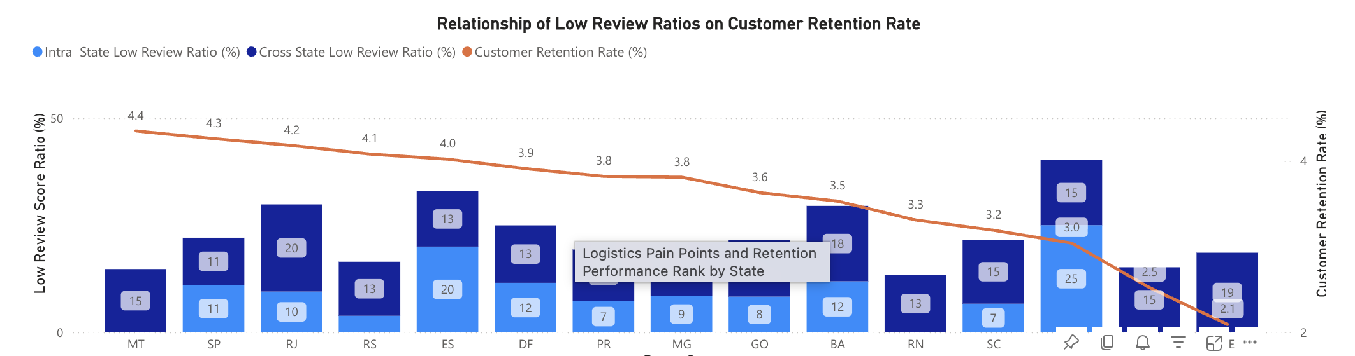
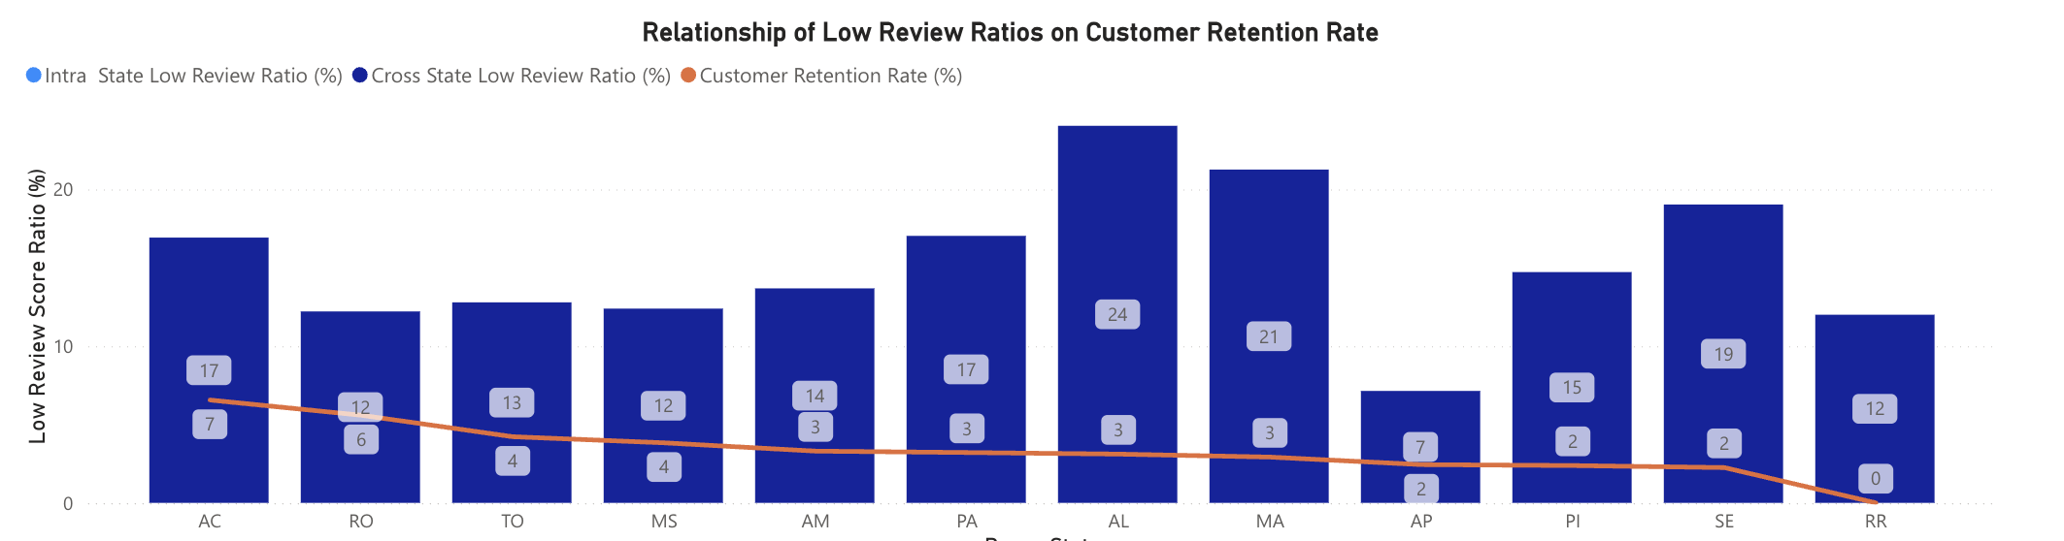
No Clear Link Between Bad Reviews & Retention
States with high bad reviews often have better repeat rates.
A bad review may also be tied to a specific product's quality or a single seller's service, rather than just the platform's shipping experience.

Slide 27
04. Conclusions

Slide 28
Conclusion
From an e-commerce perspective, resolving shipping-related pain points is the most actionable and effective way to maintain or boost customer repurchase intent.
By assessing each state's current performance, we can implement regional solutions and unlock high-potential markets:
AC & RO (High-Loyalty Potential): They maintain outstanding repeat rates (~6%) despite high costs. Lowering their shipping barriers with discounts will easily capture more high-value demand.
PA & AL (Slow Speed Bottleneck): Long 18–20 day waits drag repeat rates down to ~3%. Improving logistics speed is critical to stop customer loss.
Power BI link:
https://app.powerbi.com/groups/me/reports/ff24b445-d81a-42b7-91c9-d3b3de96930a/f99be58fba1f45a59d78?experience=power-bi

